Slide 1
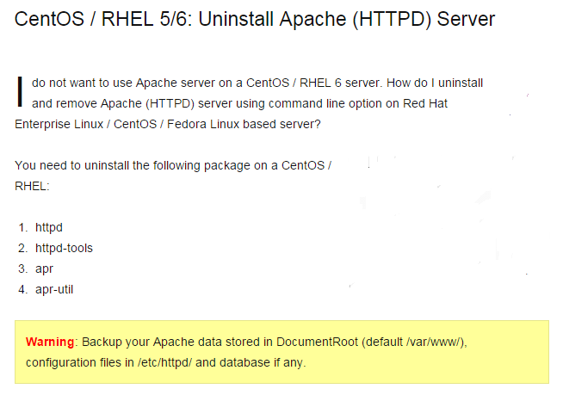
Apache Uninstall

Slide 2
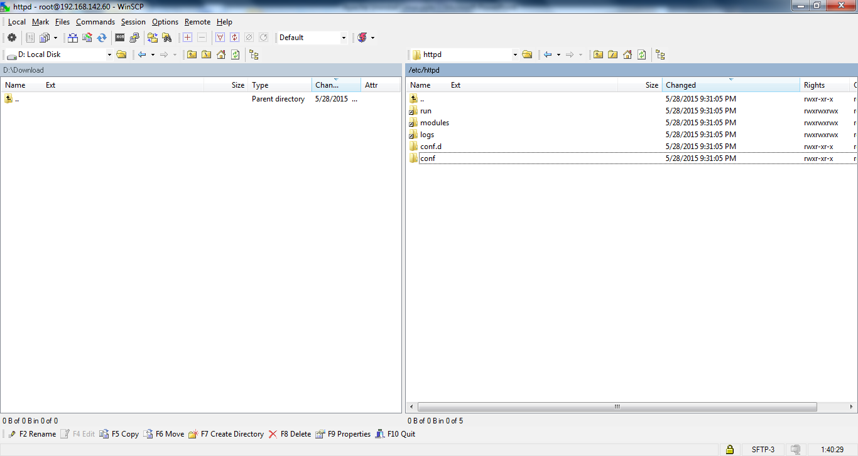
Apache Uninstall
Before Uninstall Apache (HTTPD) Server httpd folder is present.

Slide 3
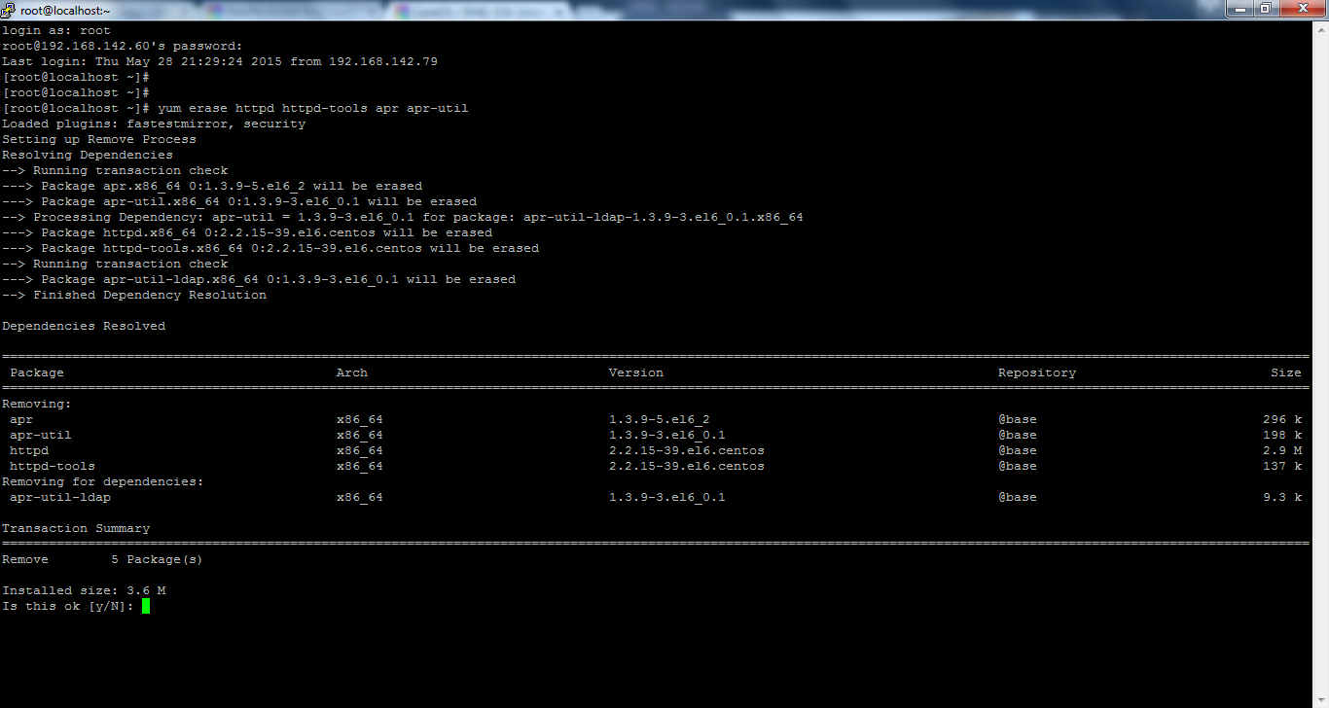
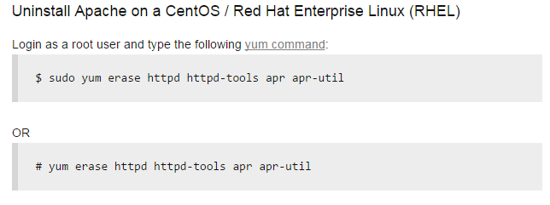
Apache Uninstall

Slide 4
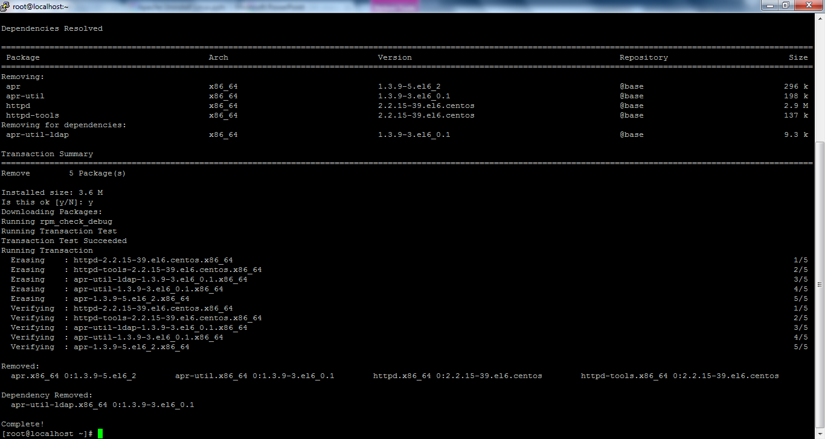
Apache Uninstall
Uninstall of Apache (HTTPD) Server is completed.

Slide 5
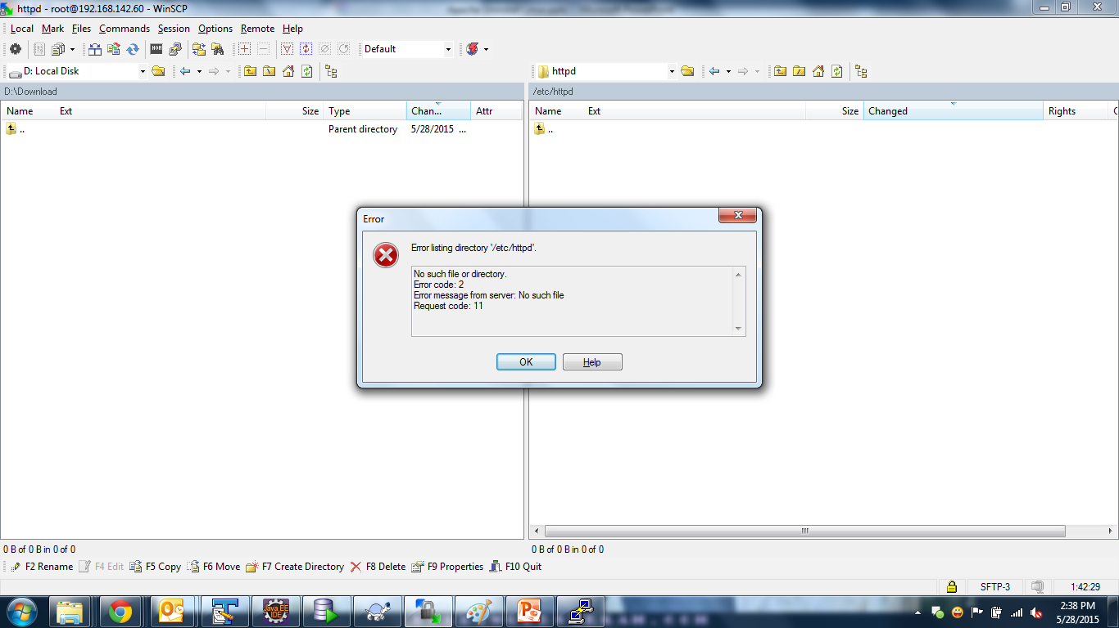
Apache Uninstall
After Uninstall Apache (HTTPD) Server httpd folder is removed.

Slide 6
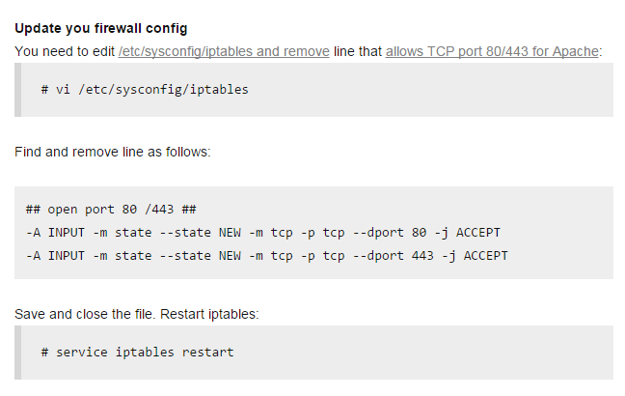
Apache Uninstall

Slide 7
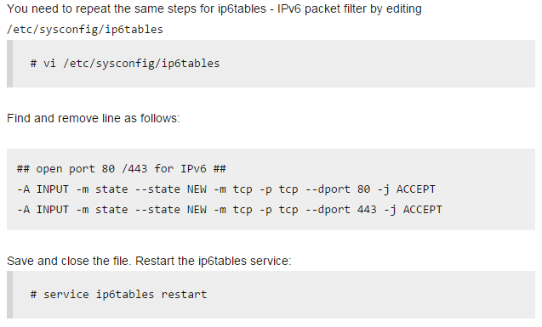
Apache Uninstall

Slide 8
Apache Uninstall
# yum erase httpd httpd-tools apr apr-util

Slide 9
Apache Uninstall
http://www.cyberciti.biz/faq/uninstall-apache-redhat-centos-rhel-fedora-linux-command/
http://httpd.apache.org/docs/

